Slide 1
Global Racialization of Muslims
Saher Selod
Associate Professor and Chair
Department of Sociology
Simmons University

Slide 2
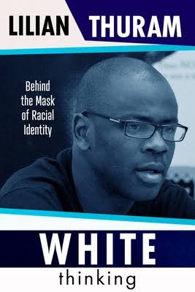

Slide 3
Definitions of Racialization
“the extension of racial meaning to a previously racially unclassified relationship, social practice, or group” (Omi and Winant, 2015: 111)
“the process by which bodies become racial in their lived realities because of biological and/or cultural traits as a result of the intersection and cooperation between ideologies, policies, laws, and social interactions, resulting in the denial of equal treatment in society” (Selod 2018; 23)

Slide 4
Why Racialization?
Sociological scholarship on race was focused on Black/White experiences.
pigmentation/phenotypical attributes
Assimilationist frameworks used to understand immigration and immigrant experiences.
ignores the centrality of race

Slide 5
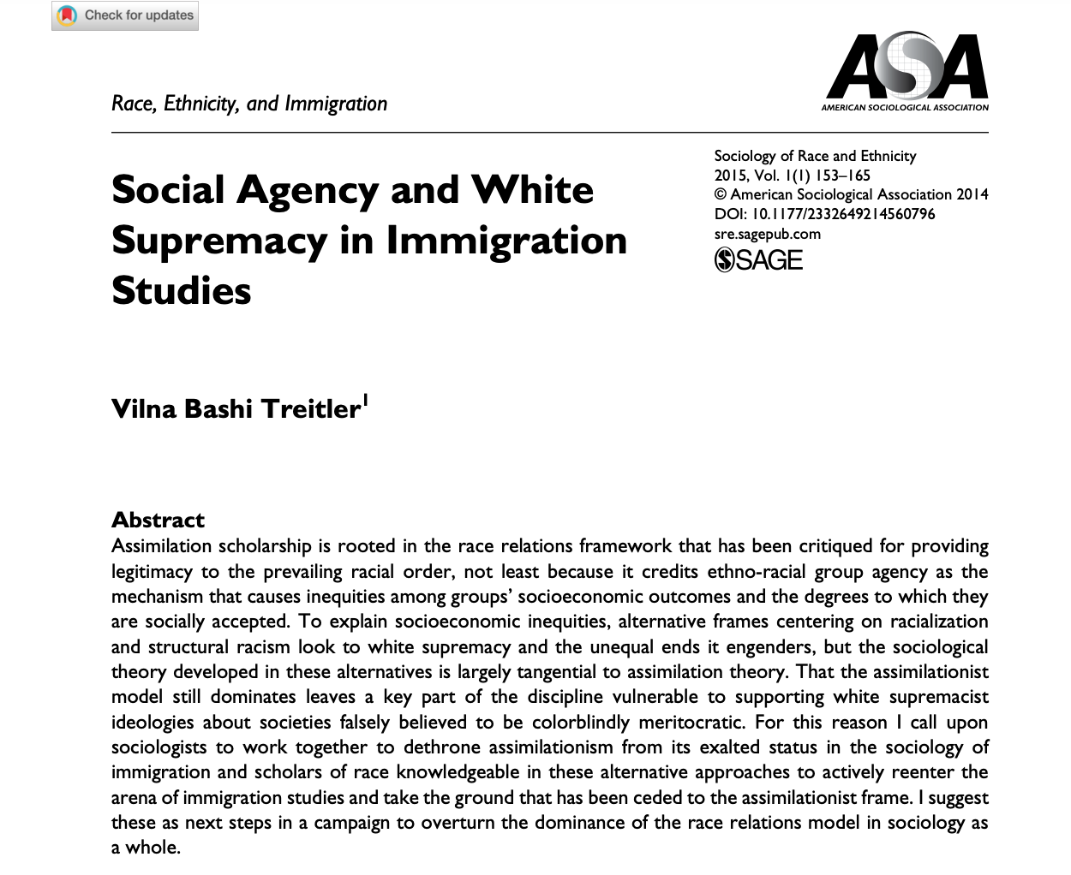

Slide 6
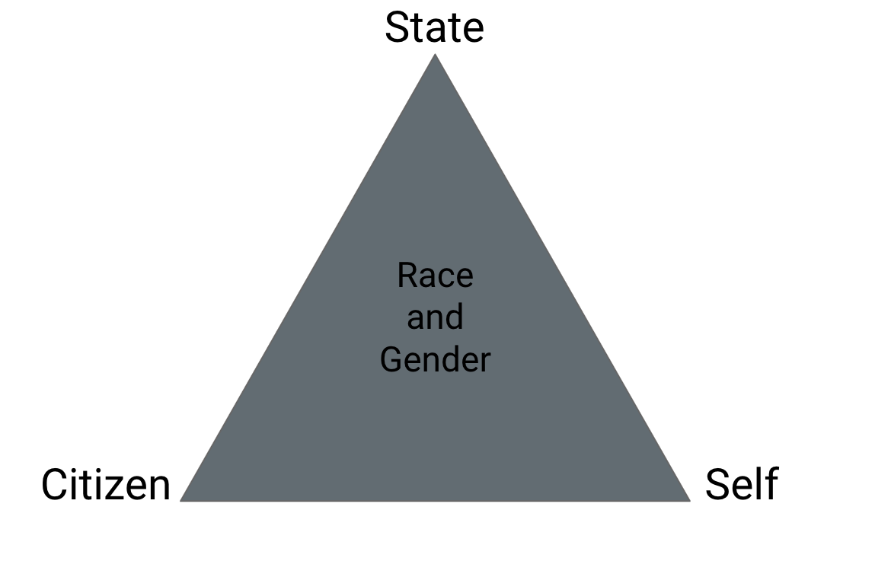
Racialized Surveillance of Muslim Americans
The hyper monitoring and observation of bodies by relying on racial cues that includes phenotype as well as cultural attributes (clothing, language, nationality).

Slide 7
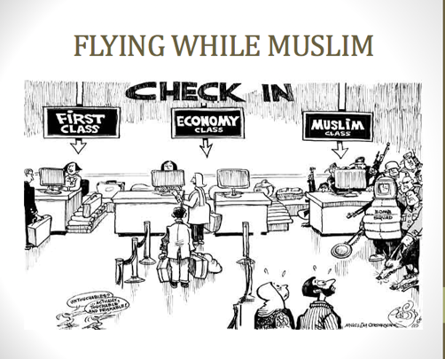
Flying While Muslim: Racialized Surveillance in Airports

Slide 8
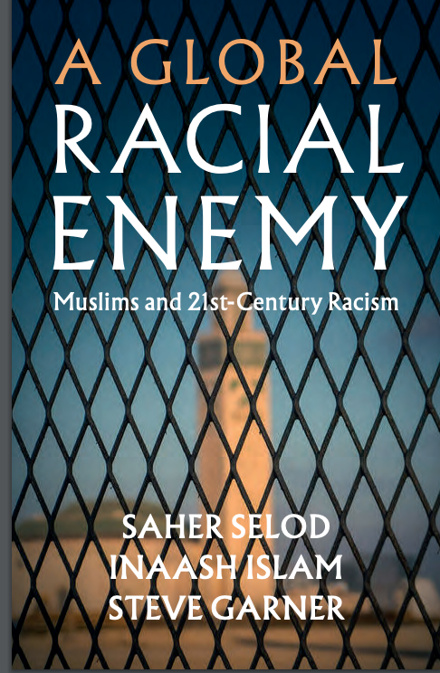

Slide 9
Global Racialization of Muslims
Key arguments:
Racialization (similar process) of Muslims operates on a global stage
Global War on Terror resulted in copycat surveillance policies that rely on the racialization of Muslims
Global racialization and surveillance of Muslims is gendered
Allows us to think beyond White Supremacy and West vs Rest

Slide 10
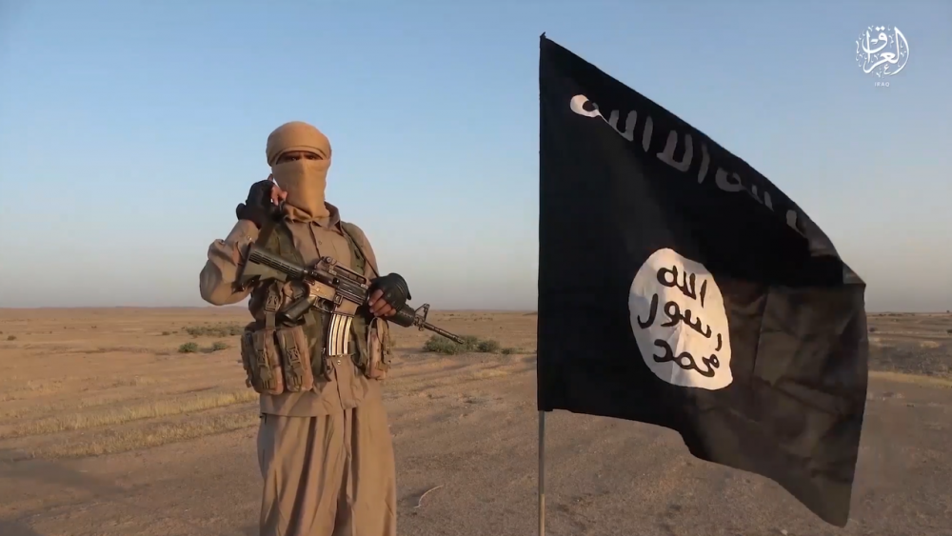
Muslim Men = Terrorist

Slide 11
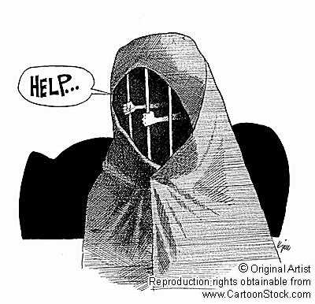
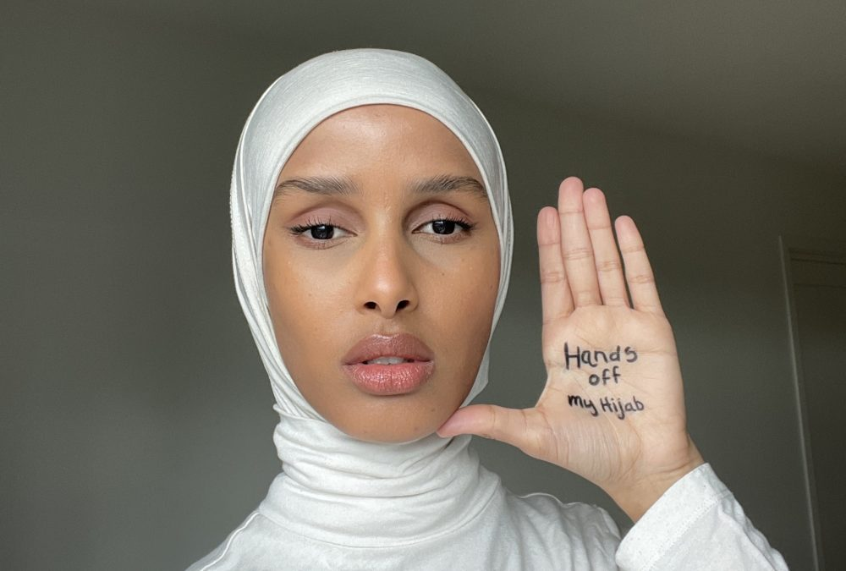
Muslim Women = Threat to Culture/Need Saving

Slide 12
Security Council Resolution 1373

Slide 13
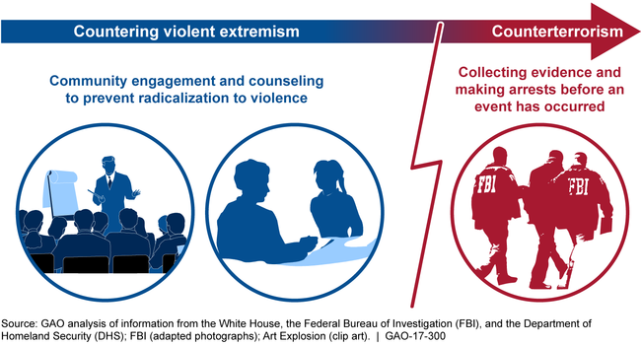
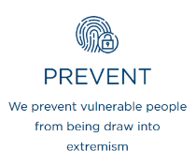
England to the United States (PREVENT/CVE)

Slide 14
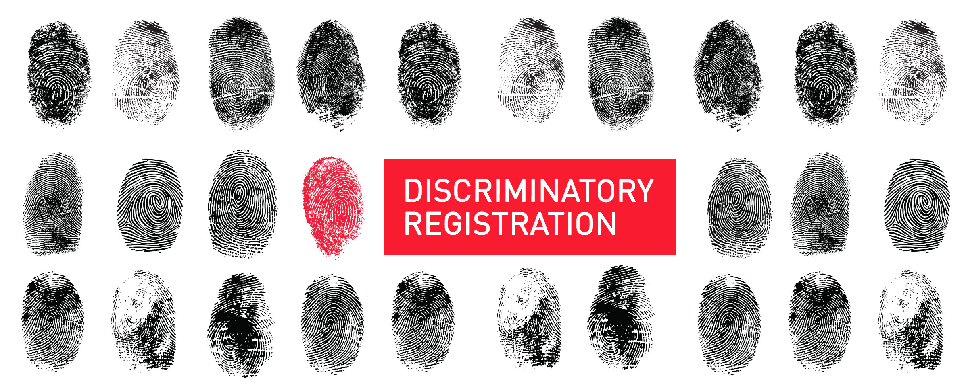
United States: NSEERS (Muslim men potential terrorists)

Slide 15
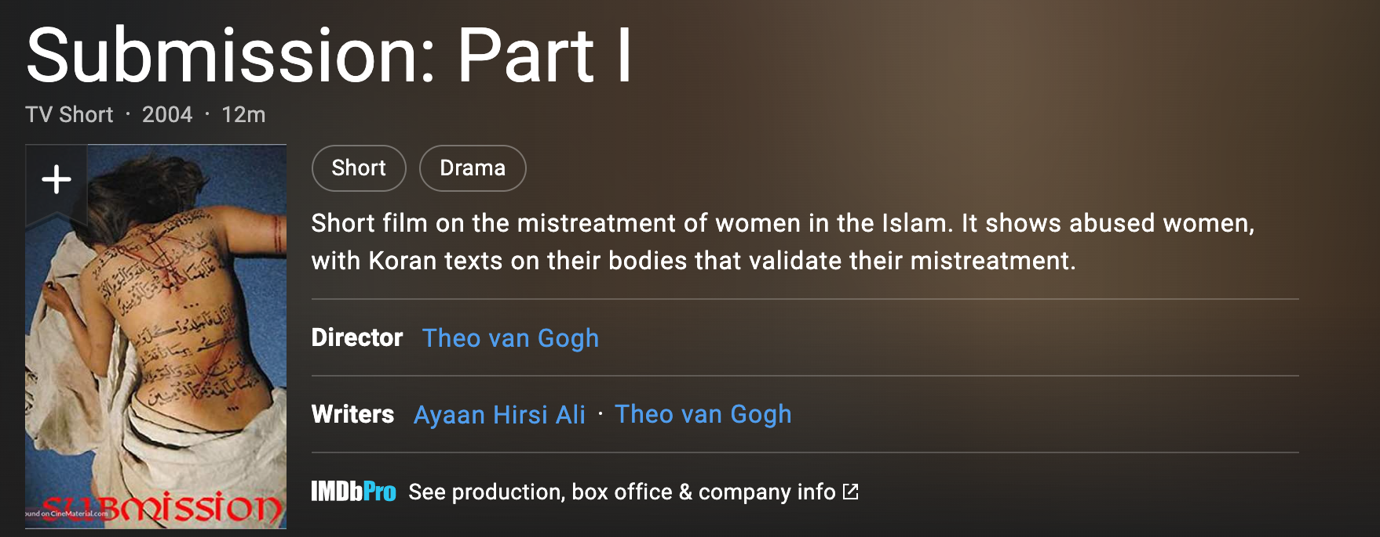
United States: Submission (Muslim women need saving)

Slide 16
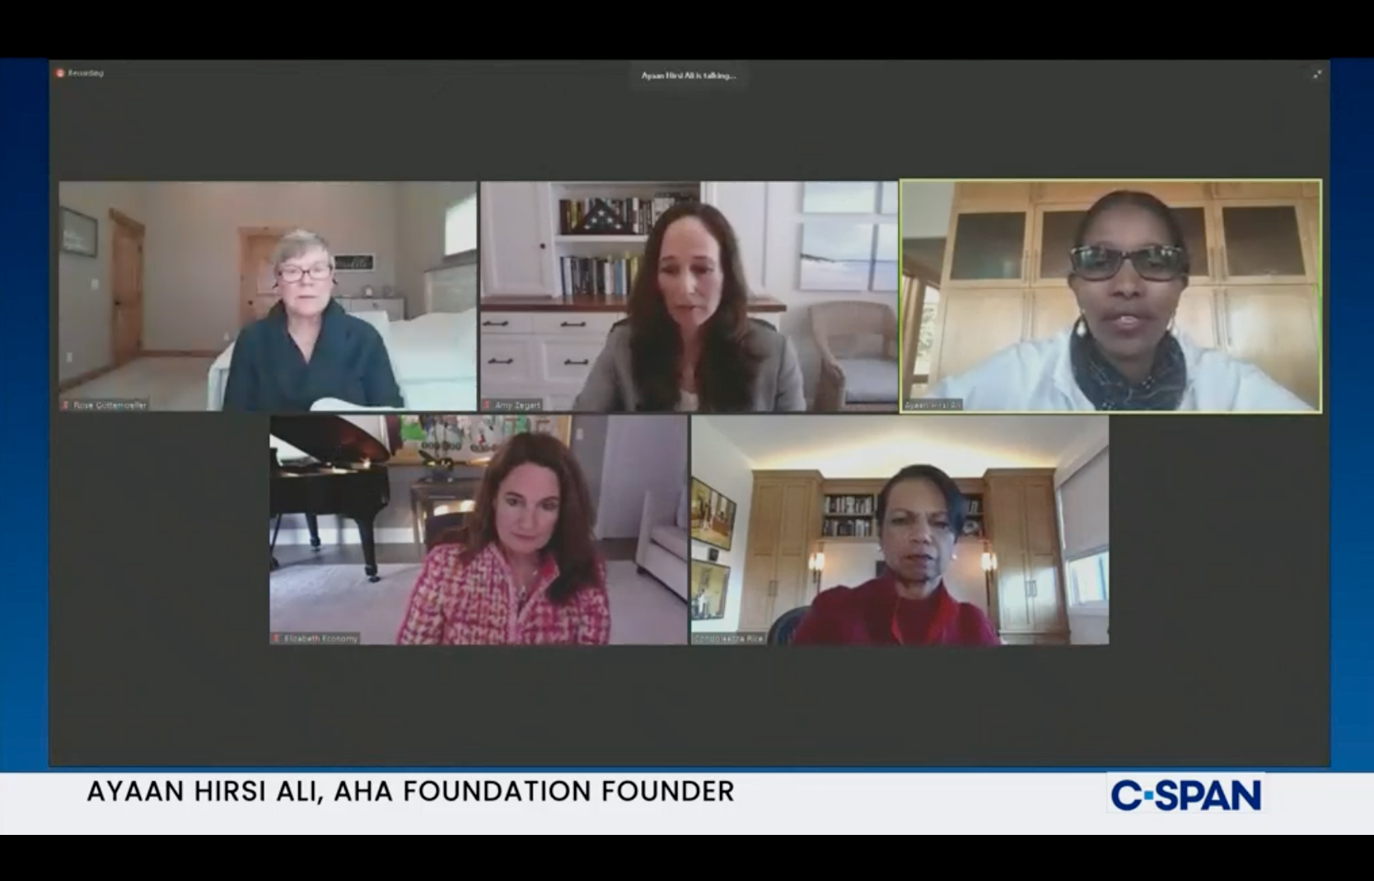
Women’s Leadership and National Security

Slide 17
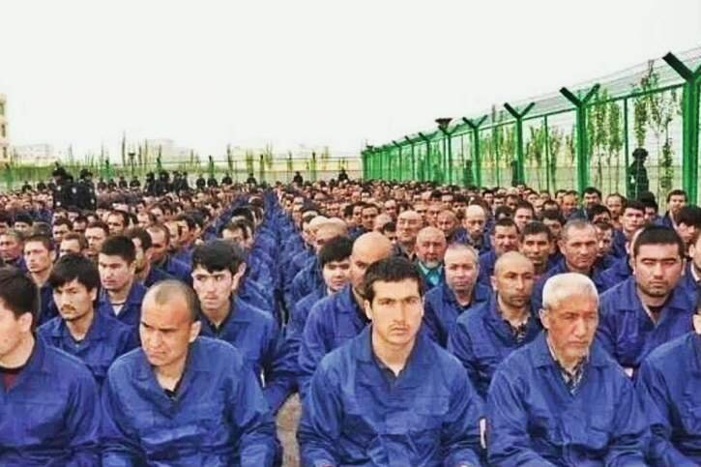
China: Uyghur Camps
Xinjiang Uyghur Autonomous Region Regulation on De-extremification (Article 9)
(4) Interfering with others from having communication, exchanges, mixing with, or living together, with persons of other ethnicities or other faiths; or driving persons of other ethnicities or faiths to leave their homes
(6) Generalizing the concept of Halal, to make Halal expand into areas other beyond Halal foods, and using the idea of something being not-halal to reject or interfere with others secular lives;
(7) wearing, or compelling others to wear, gowns with face coverings, or to bear symbols of extremification;

Slide 18
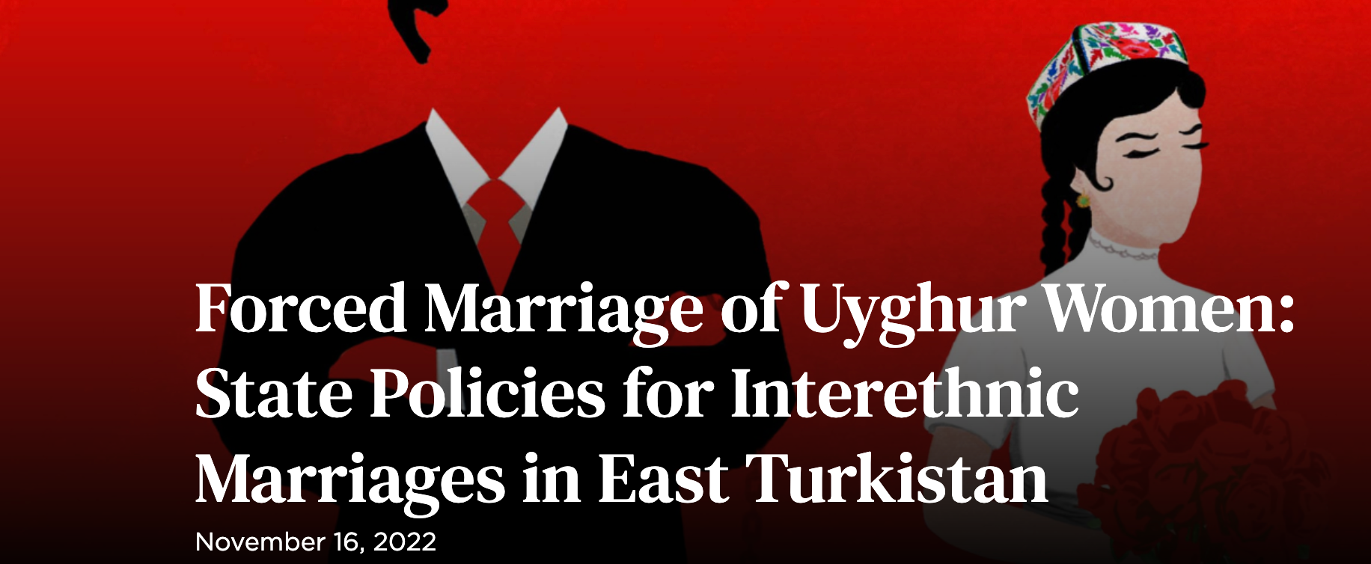
China: Forced Marriages

Slide 19
Resistance

Slide 20
Global Racialization
Epistemological contributions
Racism is a global phenomenon
Rethink our racial frameworks that center colonialist thought/white centric/US or European centric
Move away from phenotypical and biological understandings of race and racism
Identify the material and political motivations behind racialization

Slide 21
THANK YOU!!!!
CONTINUED DIALOGUE/FEEDBACK
saher.selod@simmons.edu
@SaherSelod

