Slide 1
Reconsidering Racialization from a Critical Global Race Perspective 10 Years Later: Re-Centering the Theoretical Margins
University of Michigan racism Lab 2023
Melissa F Weiner
College of the Holy Cross
mfweiner@holycross.edu

Slide 2
“Towards a Critical Global Race Theory” (2012)
Sociological response to “race/racism doesn’t exist here” while doing fieldwork in the Netherlands
From both the public AND academics, including those who taught classes on stratification
Definitions
Race vs. ethnicity
Racialization
Racism
Links to nationalism
Including how this shapes “colorblindness,” whiteness, and citizenship
10 Empirics/Indicators of Racialization

Slide 3
10 Ways to Identify Racism
Citizenship Laws
State Control
External Ascription & Boundary Permeability
Criminalization
Geography and/or Spatial Segregation
Socioeconomic status
Popular & Political Discourse and Images
Daily interactions, experiences, and cognition
International Racialized Relationships
Anti-Racist Efforts

Slide 4
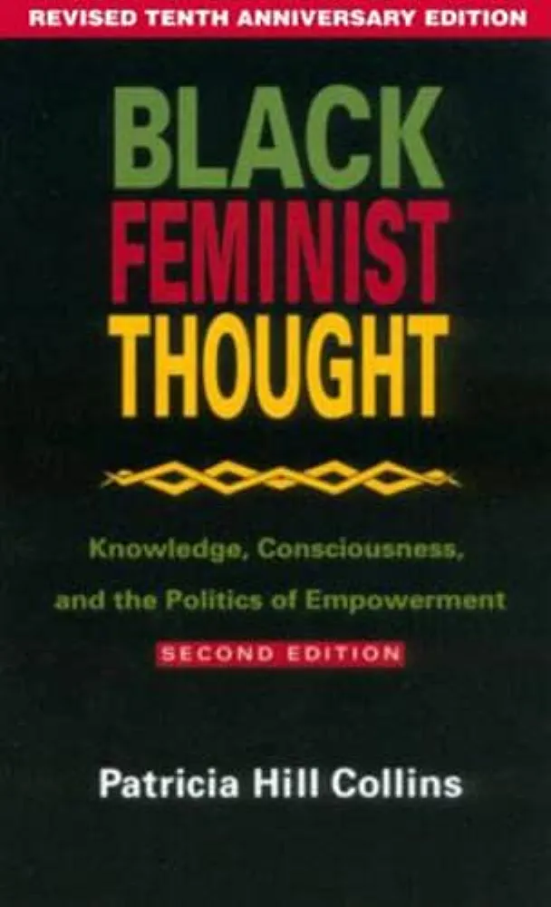
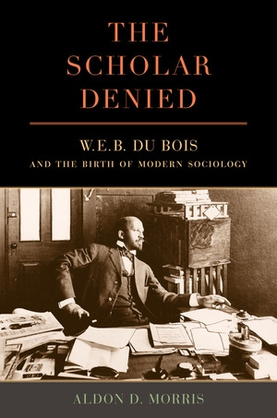
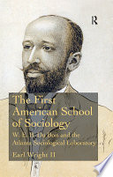
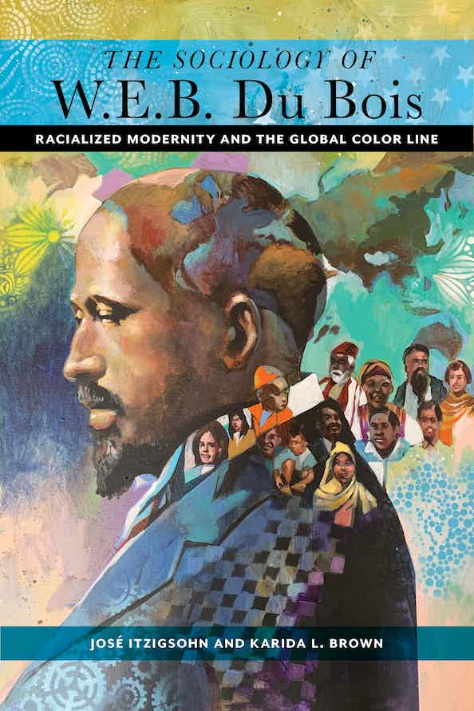
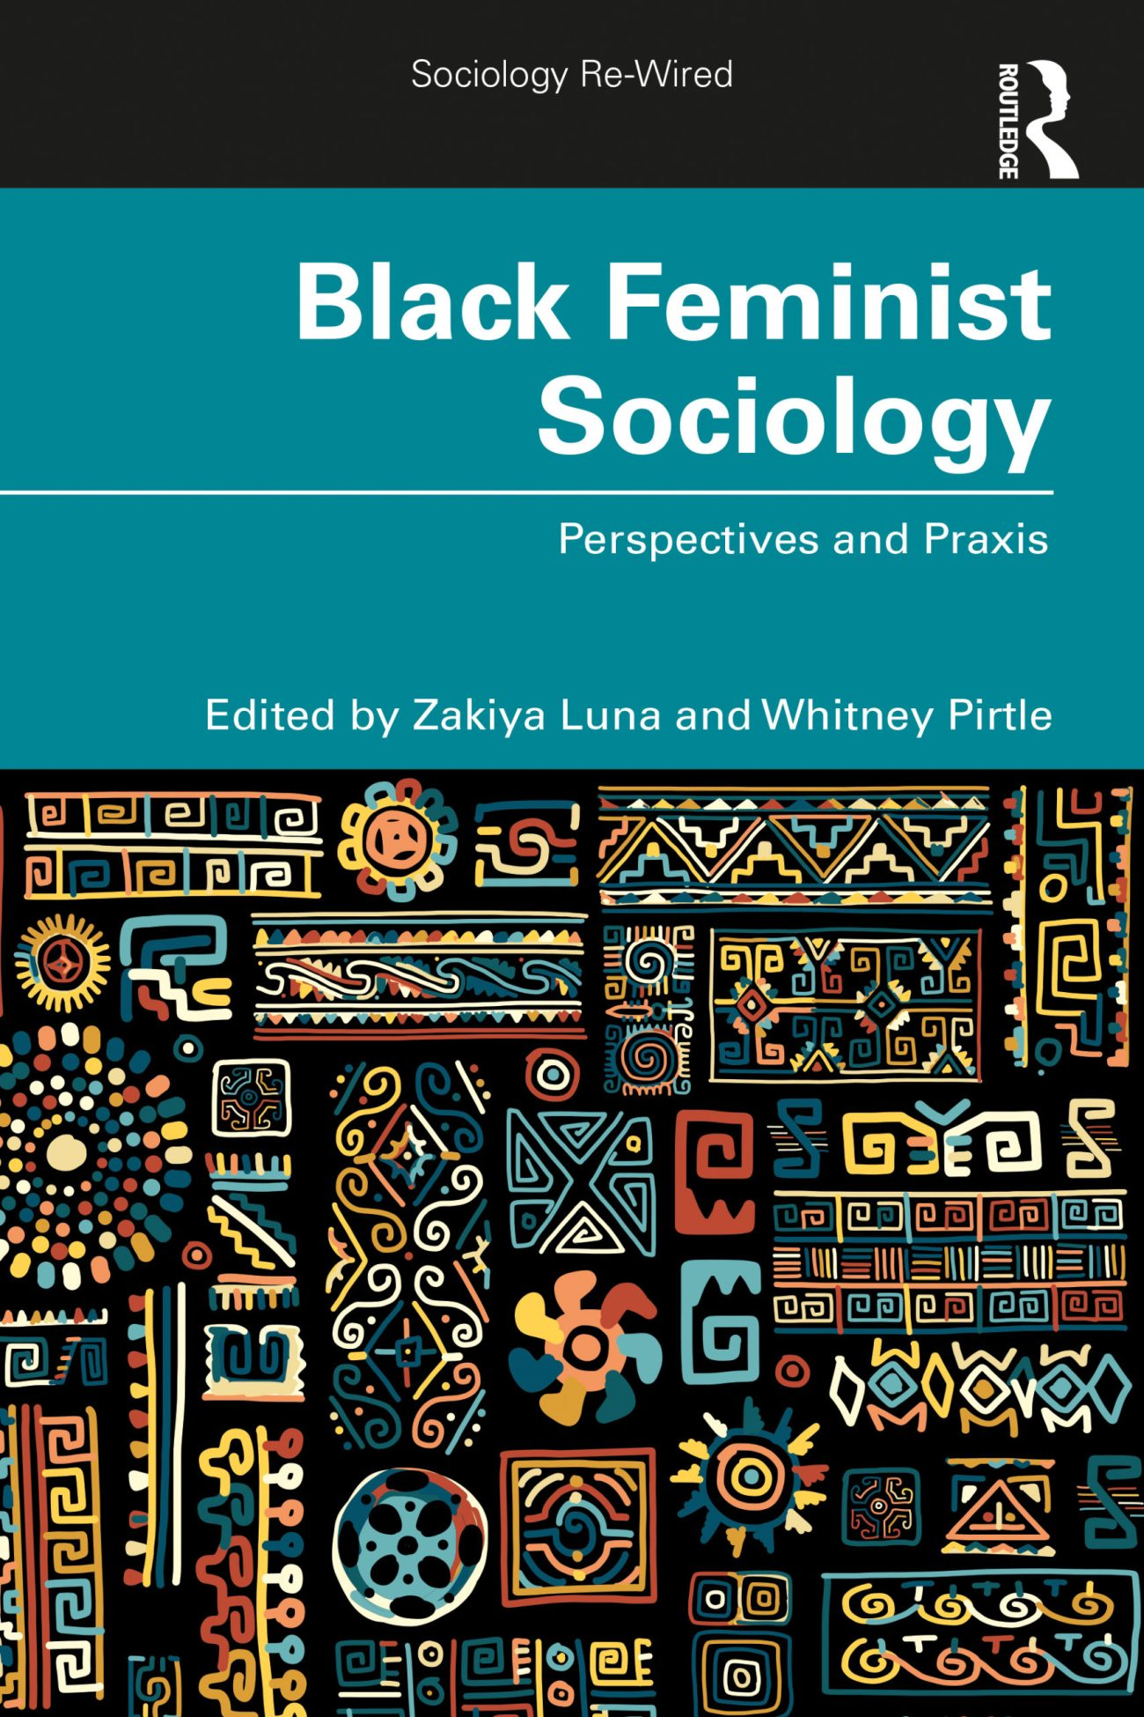
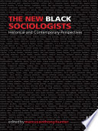
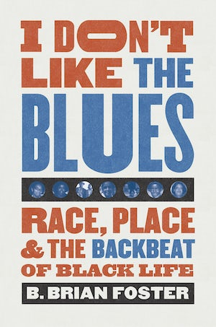
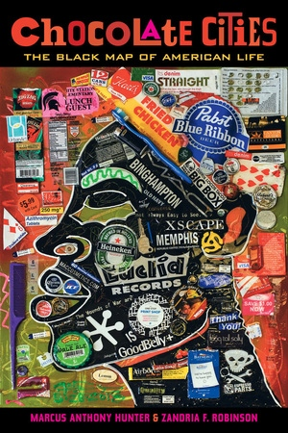
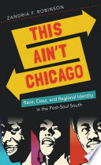
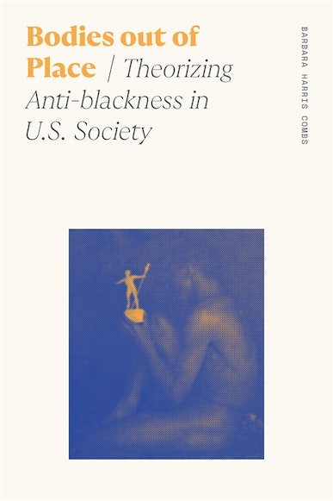
Du Boisian & Black Feminist Sociology

Slide 5
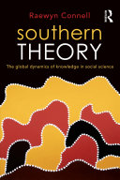
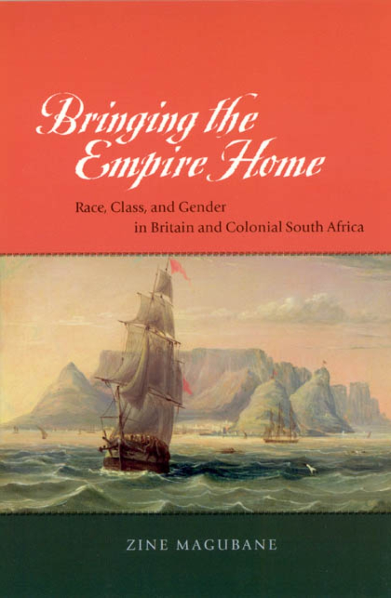
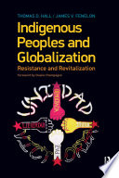
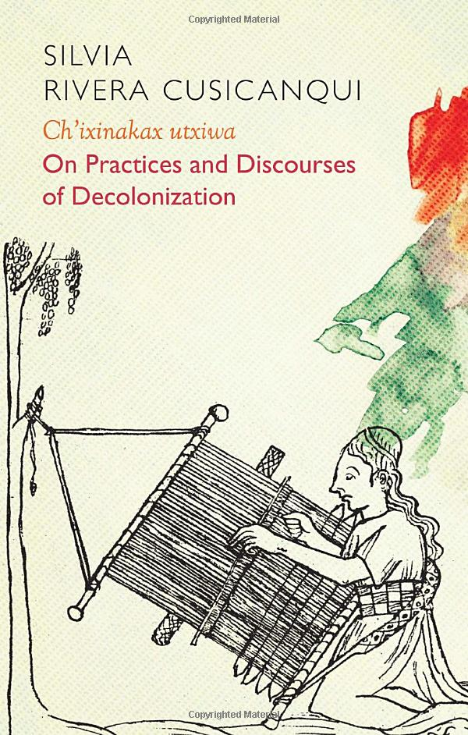
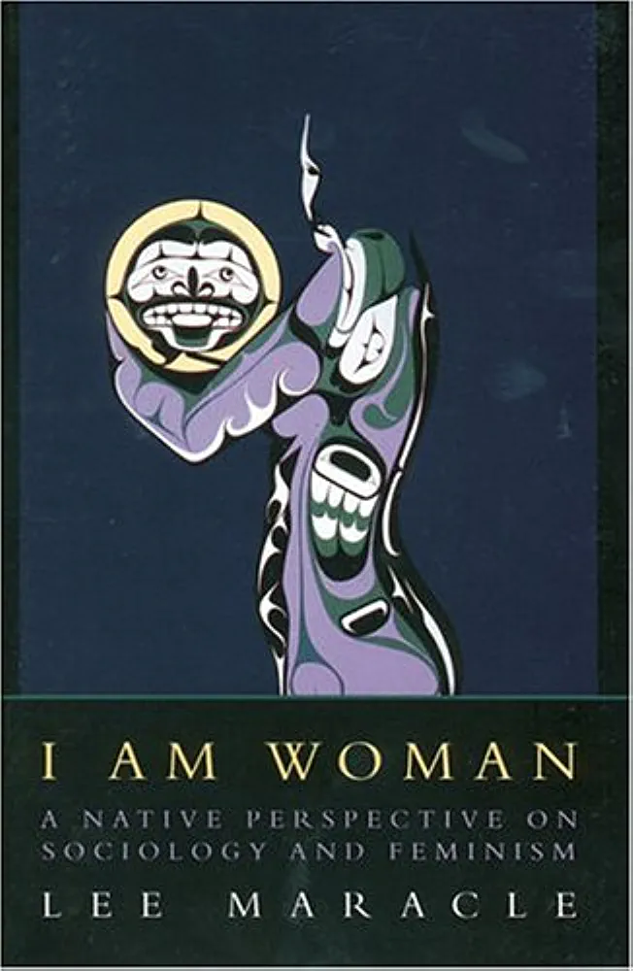
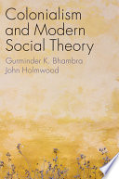
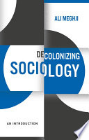
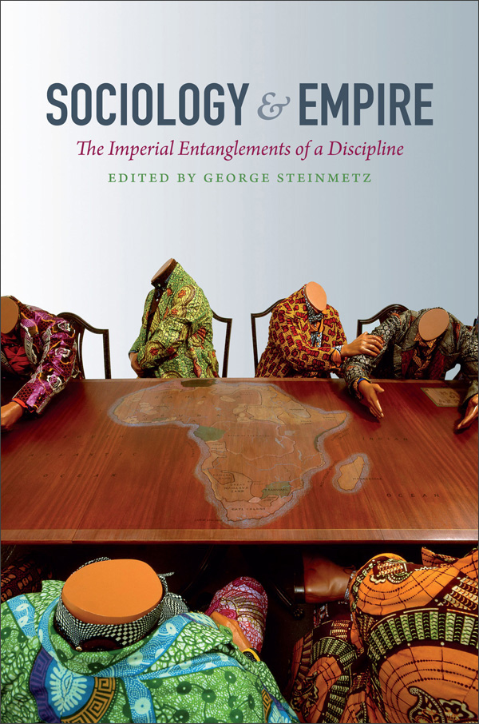
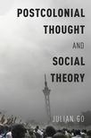
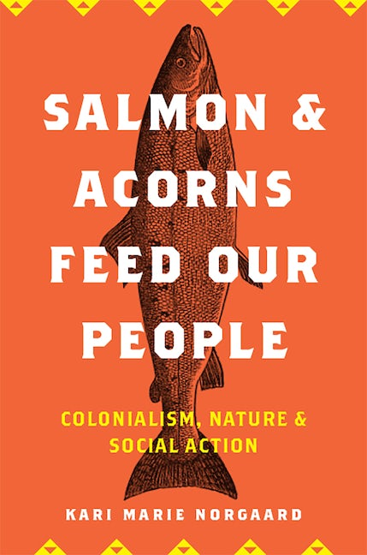
Coloniality, Empire, Indigeneity

Slide 6
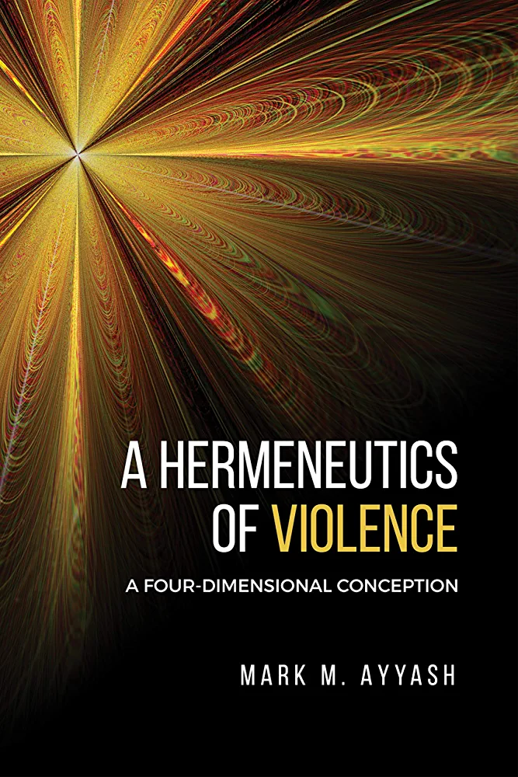
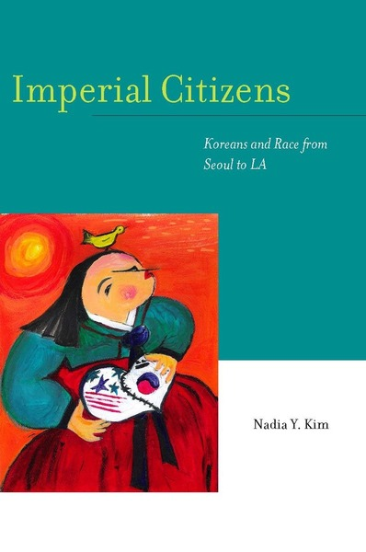
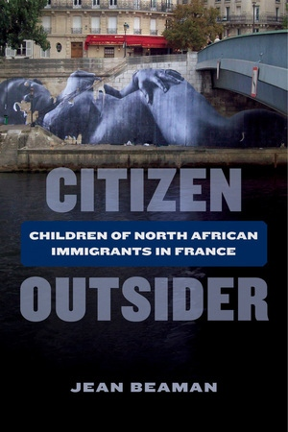
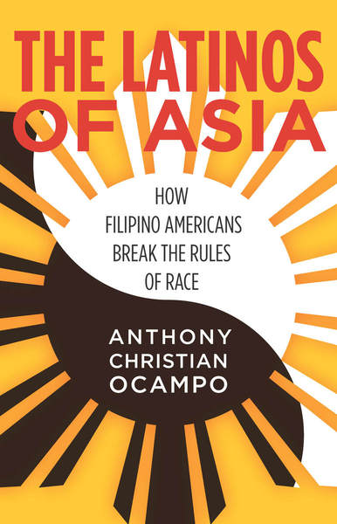
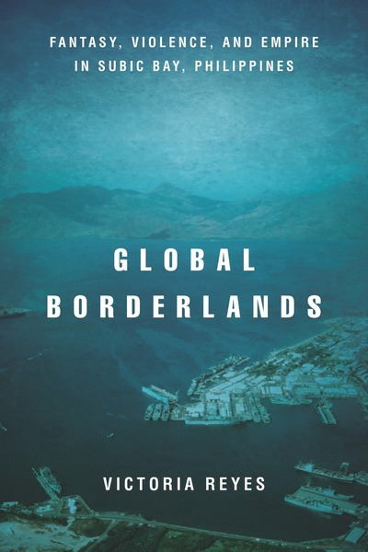
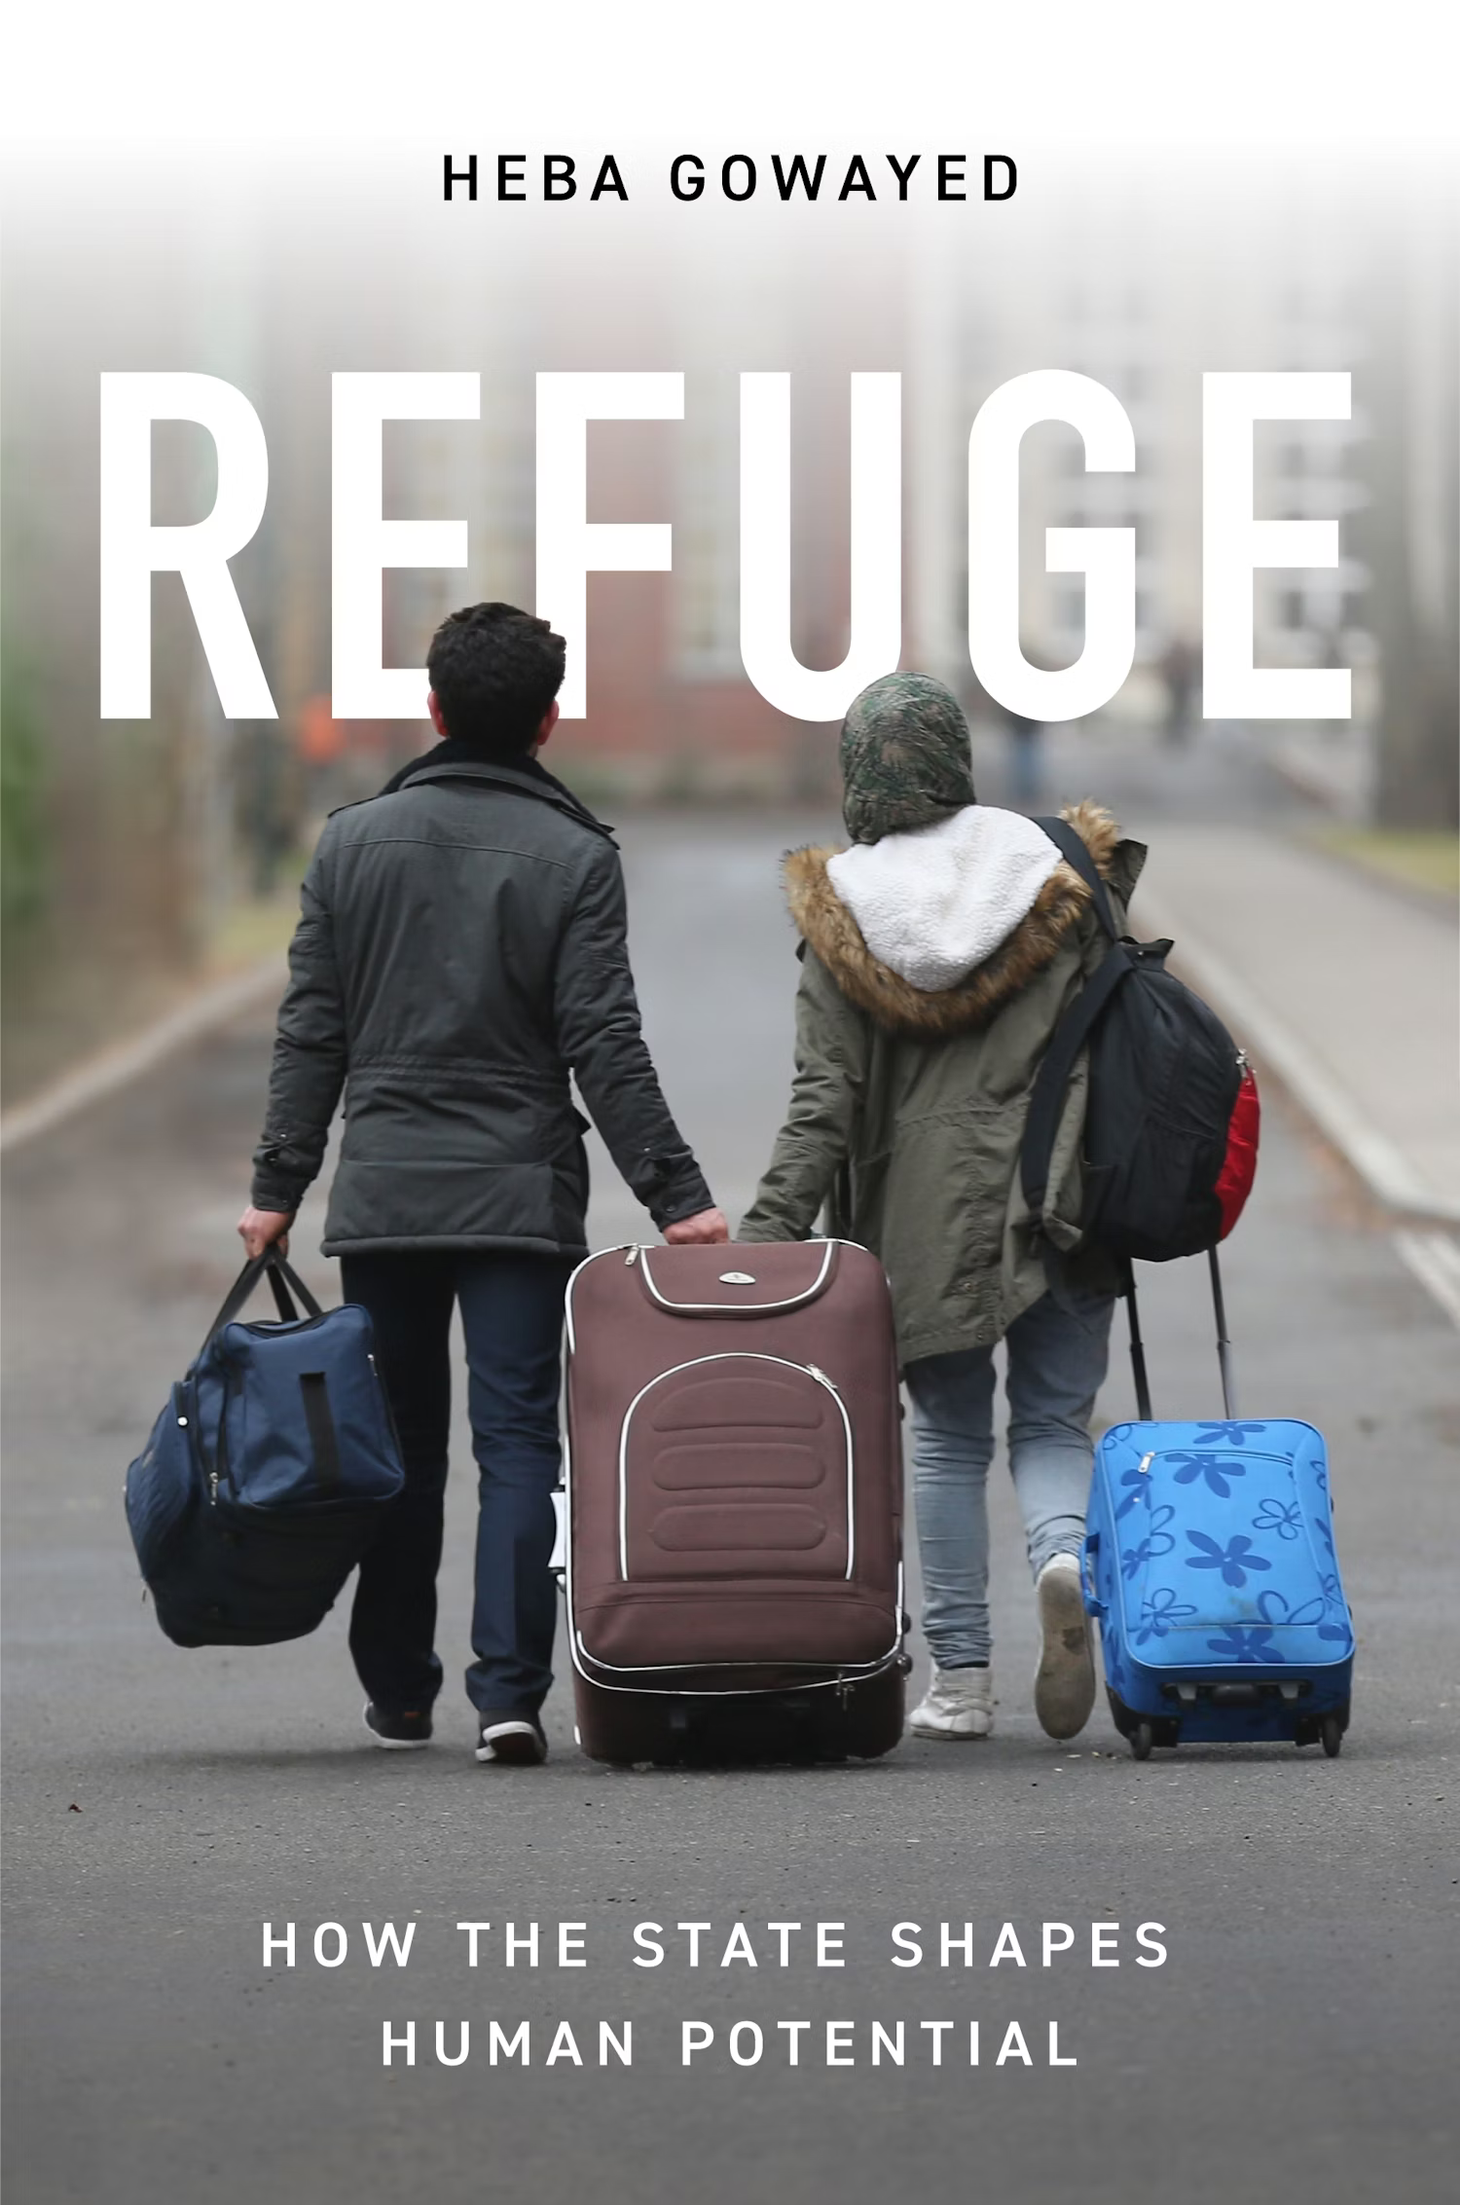
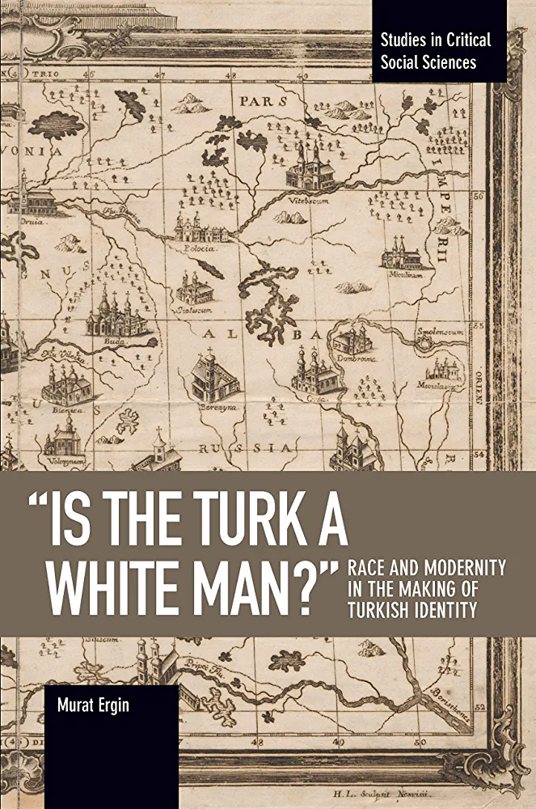
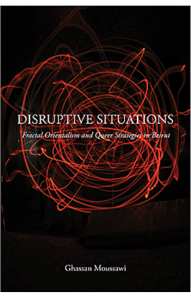
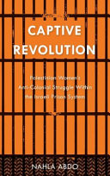
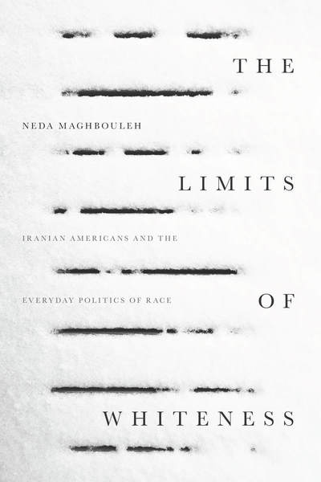
Inter/Crossnational Sociology

Slide 7
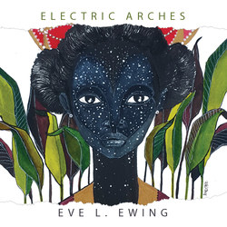
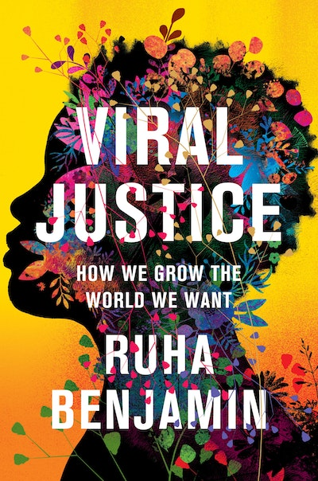
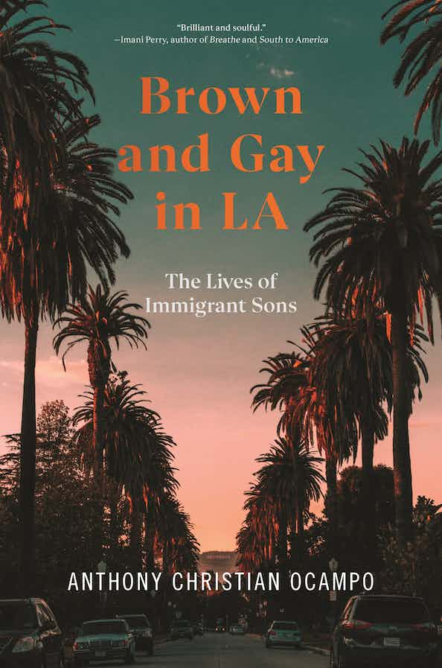
Exciting New Forms

Slide 8
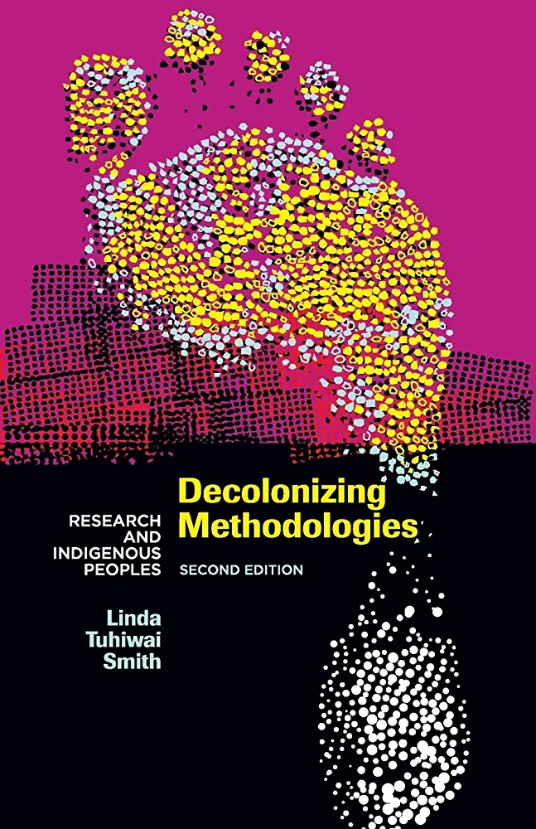
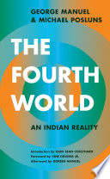
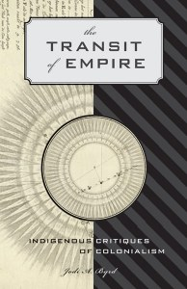
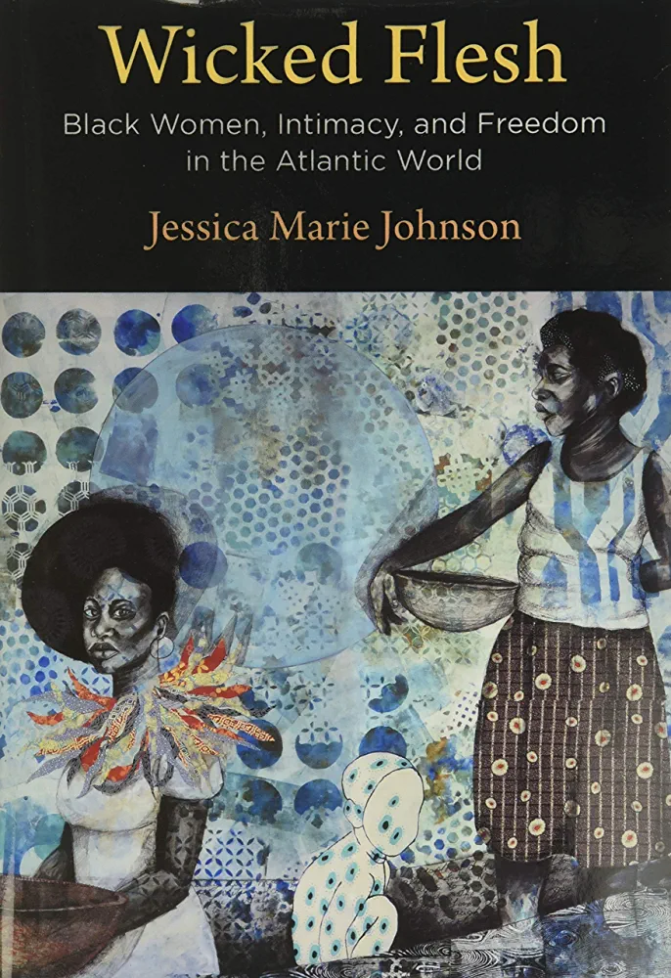
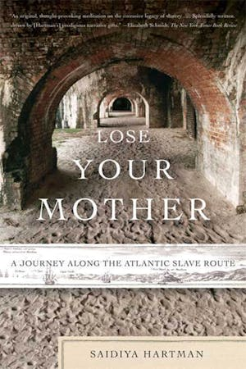
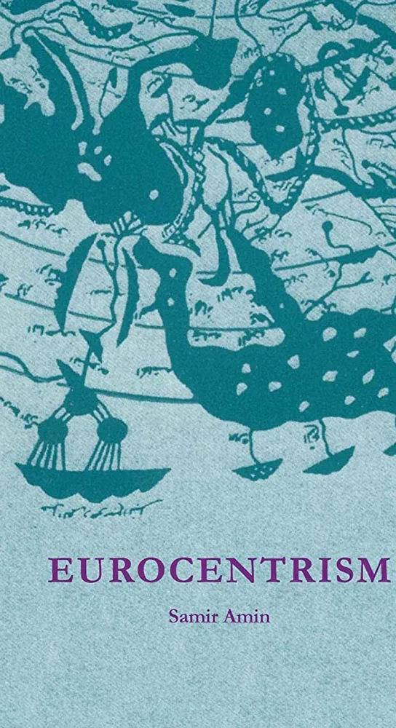
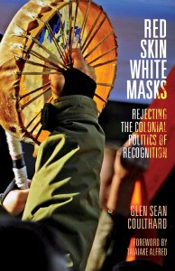
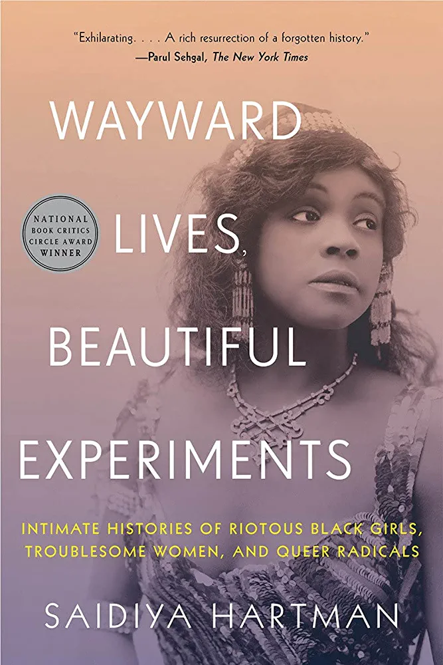
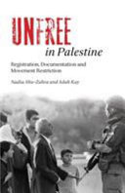
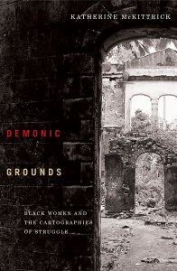
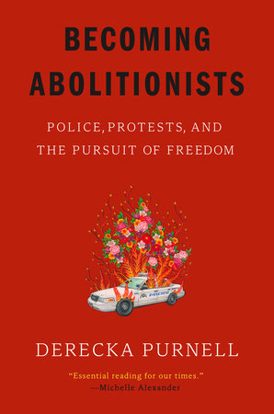
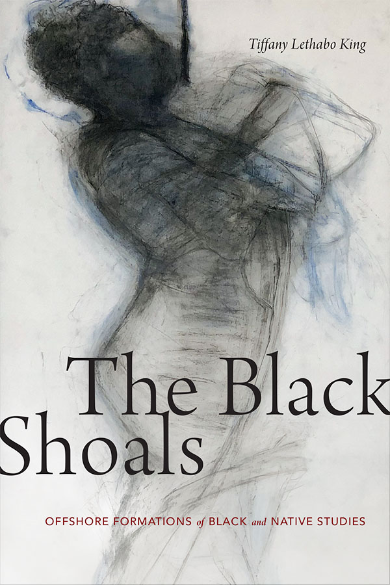
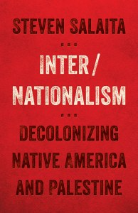
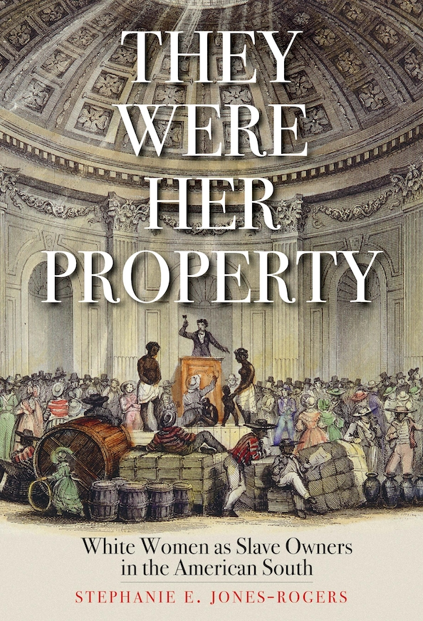
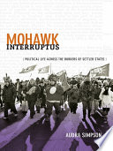
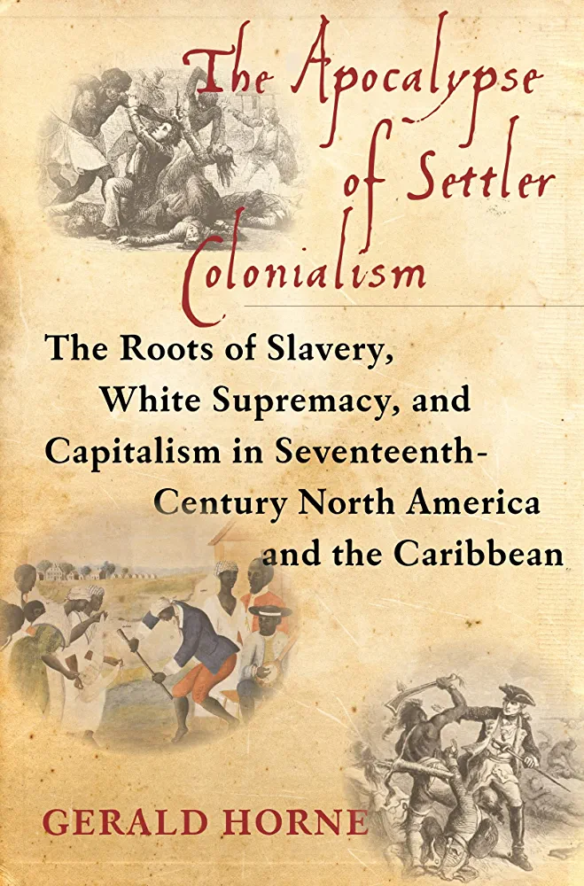
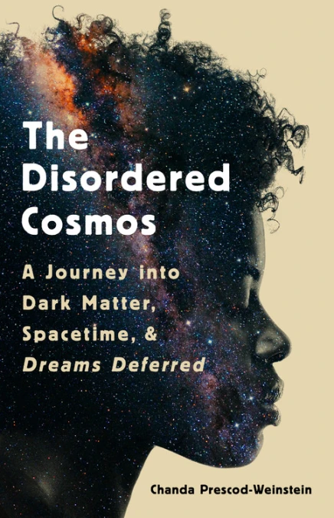
Interdisciplinary Black, Indigenous, Decolonial Abolitionist Influences

Slide 9
Shifts in My Own Research
Enslaving in New Netherland (aka New York and New Jersey), 1790-1870
Sociological conceptualization of “racialized freedom” and “racialized unfreedom”
Role of US, US citizens, and US Jews, in Palestine’s colonization
Sociological conceptualization of “complicit colonialism” and “unsettling colonizers”
From affective attachments to material consequences
Quotidian extrajudicial ways in which “regular” white people maintain white supremacy
Both, drawing heavily from the margins of Sociology, in conversation with Black Studies, Indigenous and Settler Colonial Studies, Decolonial & Abolitionist Theory

Slide 10
Measuring Racialization from the Theoretical Margins

Slide 11
Reconsidering Coloniality in Local and Global Racialization
Critical Race Theory integrated with Settler Colonial Studies
Settler colonialism as “a structure not an event” comprised of:
Land Theft
Indigenous Erasure
Settler Immigration
Racism built into legal system from onset of settler colonialism
Will then shape both that nation’s laws into the present alongside international relationships
International law features the same problem
Particularly “human rights” law, based on individual, rather than collective rights
Racial capitalism, fungibility, dehumanization (i.e. “essential workers” during covid)
Relationships to land, community, kin
Decentering of capitalism, seeks social, political, and economic relations undergirded by care for the earth and people within it
Resurgent anti-capitalist, anti-colonial movement theory building from the ground up

Slide 12
Measuring Settler Regimes and Colonial Continuities
Is the nation still a colony/colonizing?
Are existing laws’ roots in colonialism?
Normalization of physical violence, especially against women and children
Child theft/family separation
Militarized responses to protest
Land theft/lack of Indigenous sovereignty
Individual and corporate encroachment on/theft from land
Extraction of resources from land
Inability to access community land
Relationship to land today, including impermeable borders, mobility
Indigenous erasure of physical, historical presence
Destruction of family homes
Impact of Climate Change
Relationship to former colony/izer
Position within global system

Slide 13
Measuring Racialized Capitalist Extraction
Continued attention to juridical structures rooted in enslaving
Fungibility
Those most likely to be considered objects, enslavable, exploitable
Particularly women, and control over reproductive freedoms
Roots of enslaving within institutions and how people experience those institutions today
Personal and institutional intergenerational transfer of wealth
Roots of enslaving in laws and legacies of these today
i.e. Voting in the US, anti-Blackness in border policing
Coerced labor practices
White supremacist resource and profit extraction
Benefits accrued through existing white supremacist system
Intergenerational wealth extraction and accumulation

Slide 14
Where do we go from here?
Continued attention to ongoing coloniality, especially neocolonialism, and its impacts on racialization and material consequences
De-centering of US scholarship, especially in journals
Less “about them but without them” scholarship
Citational practices
Consideration of own positionality in discerning research projects
Considering how we can materially contribute to decolonization
Attention to historic roots of race in the US
Colonialism, Empire, Enslaving and how these shape lives of all (esp. White colonizers) today

Slide 15
Thank you!
Contact: mfweiner@holycross.edu

